Slide 1
Ace Your Blink Rate
Submitted in the partial fulfillment for the award of the degree of
BACHELOR OF ENGINEERING
IN
Artificial Intelligence & Machine Learning
Submitted by:
Dandala Bhagath Reddy : 18BCS6196
Mulla Thanuj Kumar Reddy: 18BCS6156
Devendra Reddy Bakka : 18BCS6175
Under the Supervision of:
Mr. Prince Jain
Department of AIT-CSE
DISCOVER . LEARN . EMPOWER

Slide 2
Outline
Introduction to Project
Problem Formulation
Objectives of the work
Methodology used
Results and Outputs
Conclusion
Future Scope
References

Slide 3
Introduction to Project:
People who spend a lot of time in front of screens, there's a high chance they’ve computer vision syndrome suffer from various eye problems like eye fatigue, headache, blurry vision, tearing or red eyes major one being dry eyes cause dropped blinking rate.
According to the research of Iowa Hospitals a person blinks up to
66 % less frequently while using a computer. This accommodative method causes blur vision, double-vision, Presbyopia, Myopia and slow focal change.
After watching desired content people unintentionally end up continuously looking at useless content

Slide 4
Introduction to Project:
A cross platform background running application built using electron to smartly to control screen light to turn on/off based on whether his eyes are open or not.
It is a useful to control the display light considering situations, it automatically turn off display light by detecting user eyes while the user will close his eyes, immediately turn on screen while he opens his eyes and keep the screen-on while no eyes are detected.
It is ignores the casual blinks that are under 1.5 sec to avoid screen flickering
This counts total amount of time from your last blink and set notifications to display an alert message ,to remind that you haven’t close your eyes for long time, will give a pop up message while the user has not blinked in last 13 seconds to remind you to close your eyes for a while and protect your eyes

Slide 5
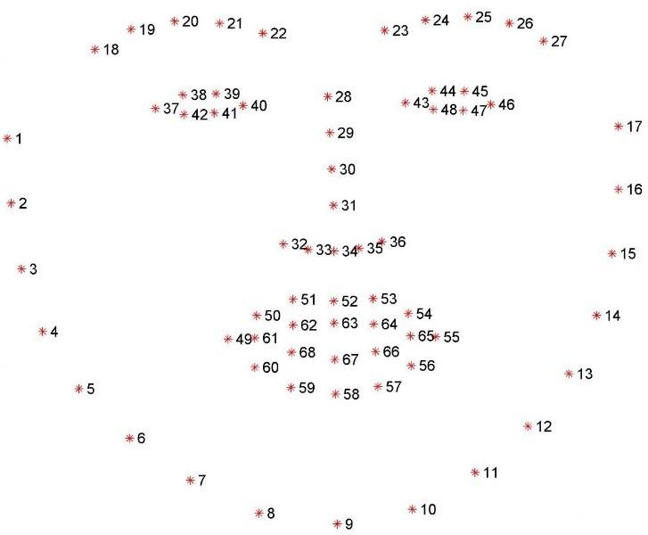
Problem Formulation:
Detecting blinks using facial landmarks and OpenCV:
Initialize face-detector dlib and facial landmark detector, dlib uses a pre-trained face detector
By this we can determine the starting and ending array of index values (x, y)-coordinates the left eye and right eye.

Slide 6
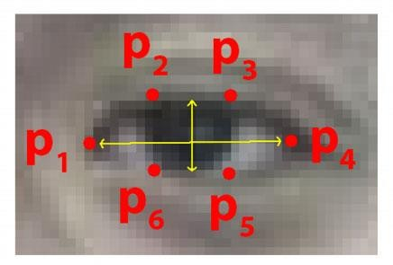
Problem Formulation:
Face landmark detection to localize eyes:
We calculate eye aspect ratio for each eye, that gives the distances between vertical eye landmark points to the distances between horizontal land-marking points
We represent it as 6 coordinates (x, y) it starts from the left most corner of the eye and move clockwise around the remaining regions

Slide 7
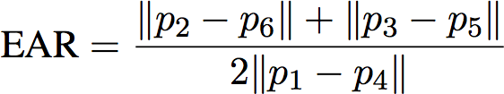
Problem Formulation:
The relation between the coordinates with respect to width and the height . Eye aspect ratio (EAR) formula:
||P2-P6||+||P3-P5|| → used to calculate distance between vertical eye landmarks
2||P1-P4|| → used to calculate distance between horizontal eye landmarks

Slide 8
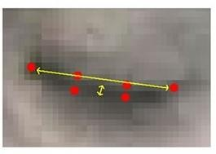
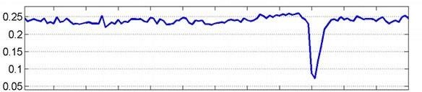
Problem Formulation:
EAR is approximately constant while the eye is open, and goes down to zero when a blink take place.
→
The graph shows EAR is constant (if the person keep his eyes opoen), Then drops near to zero and increases again, This indicate a blink has completed.

Slide 9
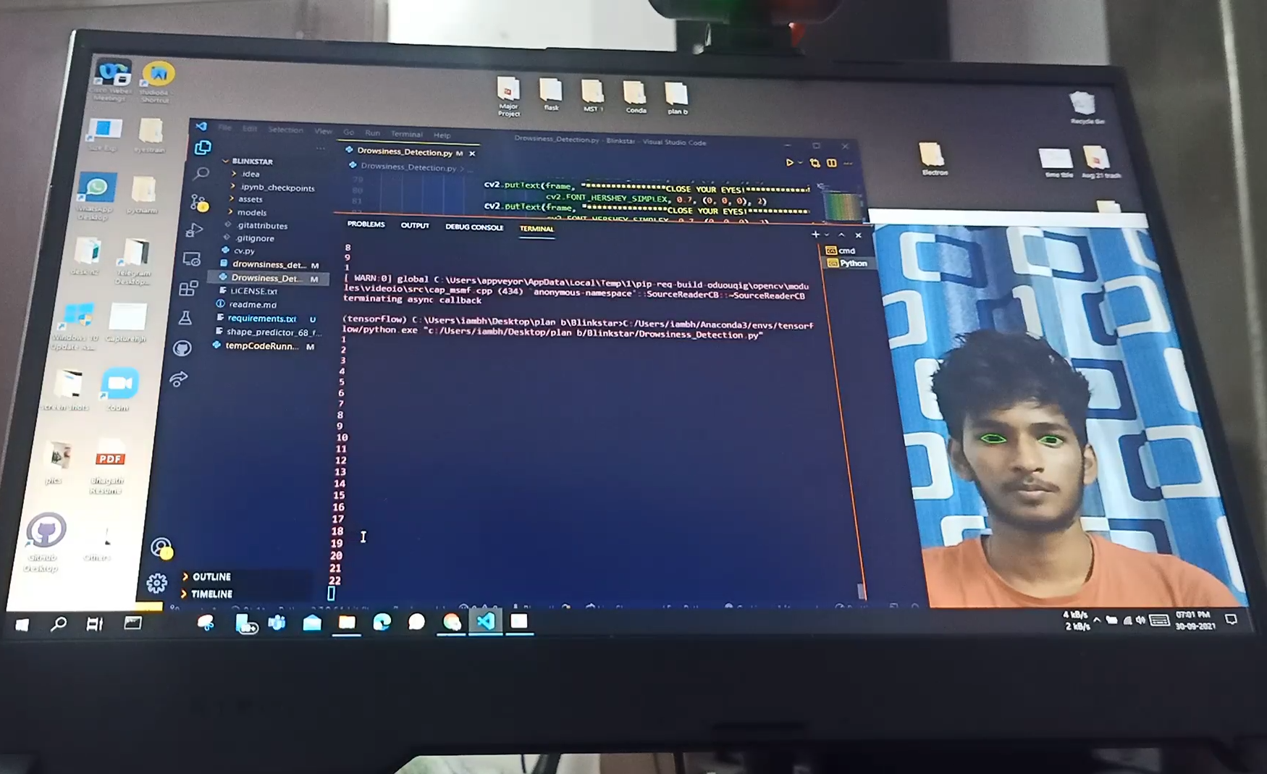
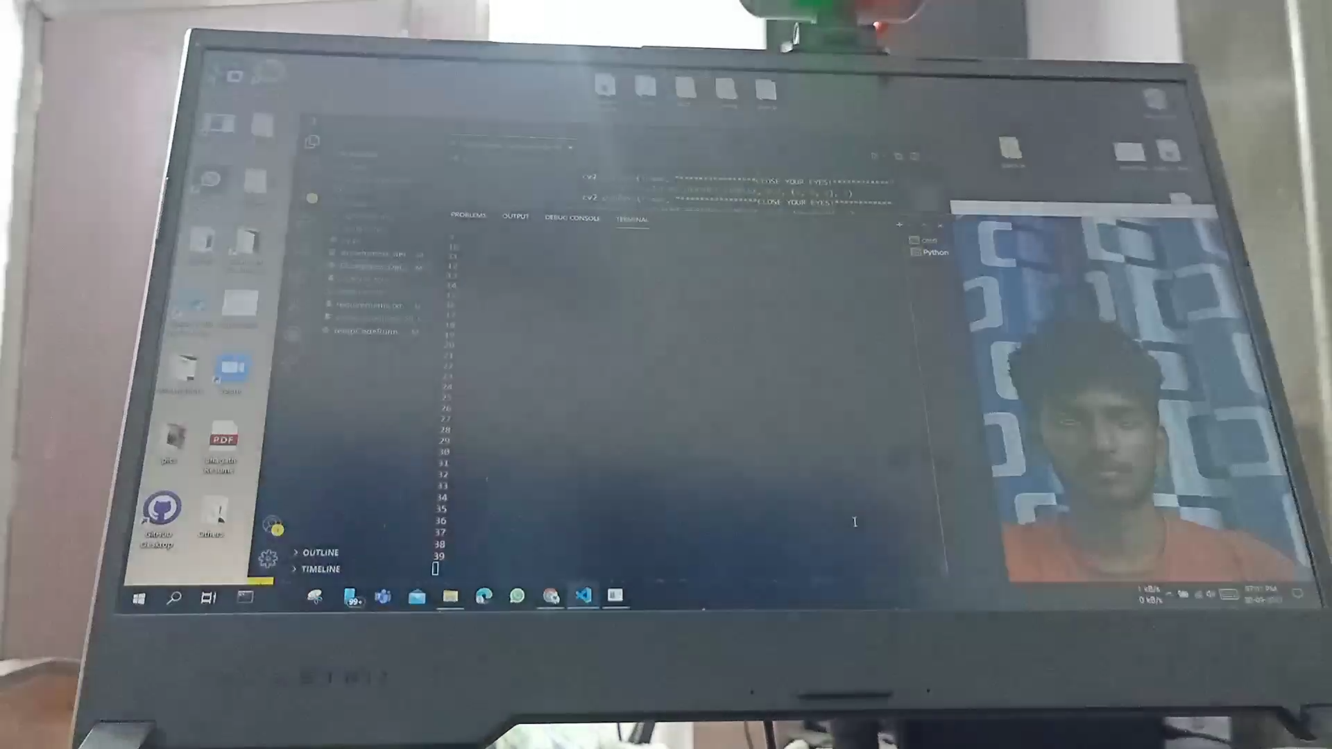
Problem Formulation:
Display light control with respect to blink detection:
A background application useful to control the display light considering conditions:
It automatically turn off display light by detecting user eyes while the user will close his eyes, immediately turn on- screen while he opens his eyes
keep the screen-on while no eyes are detected.

Slide 10
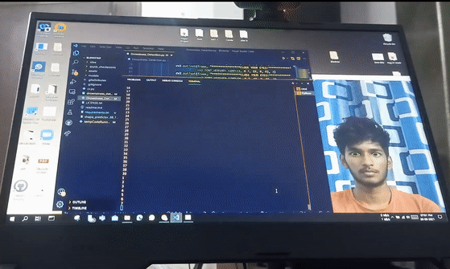
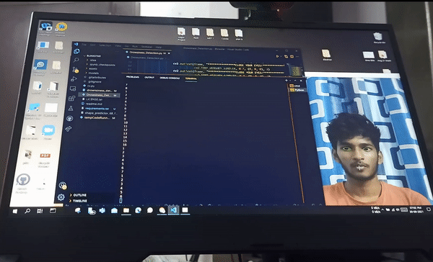
Problem Formulation:
Trained to ignore the casual blinks that are under 1.2 sec make display light stable to avoid screen flickering
Blink Time > 2 seconds Blink Time < 2 seconds

Slide 11

Problem Formulation:
Count the total amount of time that you had not blink till last blink
set notifications to display an alert message to remind you to close your eyes
will gives a message while the user has not blinked in the last 13 seconds (as per the user settings)
Pop up notification Reminder

Slide 12
Objectives:
1. Detecting blinks using facial landmarks and OpenCV python for Eye blink detection
2 Facial landmark detection to localize eyes and find Eye Aspect Ratio(EAR)​
3 control the display light considering situations
4 automatically turn off display light detecting user eyes while the user will close his eyes , immediately turn on-screen while he opens his eyes
5 keep the screen-on while no eyes are detected It is trained to ignore the casual blinks that are under 1.5 sec make display light stable to avoid screen flickering
6 count the total amount of time that you had not blink till last blink , set notifications to display you an alert message to remind you to close your eyes ​

Slide 13
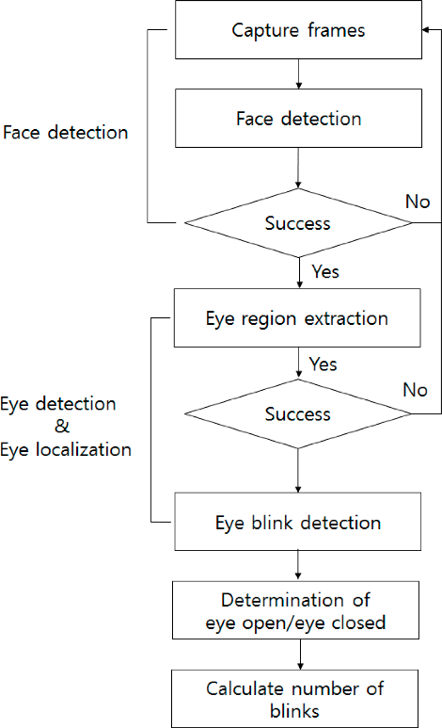
Methodology used:
To count no of Blinks:

Slide 14
Methodology used:
Application:
→ Control the display light considering situations
→ Automatically turn off display light detecting user eyes while the user will close his eyes
→ Immediately turn on-screen while user opens his eyes
→keep the screen-on while in case no eyes are detected
→ It Ignore the casual blinks that are under 1.2 sec make display light stable to avoid screen flickering
→ count the total amount of time that you had not blink till last blink
→ set notifications to display you an alert message to remind you to close your eyes
→ will give you a pop up message while the user has not blinked in the last 13 seconds (as per the user settings) displayed over any application that you're currently using

Slide 15
Methodology used:
→ Increases privacy and productivity of the user as people likely tend to watch useless content after completing the desired content
→ application is made using a cross-platform electron framework Electron
→ is a new framework that allows developers to employ web technologies (JavaScript, HTML and CSS) to create cross-platform desktop applications

Slide 16
Results and Outputs:
Turn off display light by detecting user eyes in case the user will close his eyes, turn on-screen in case the user opens his eyes

Slide 17
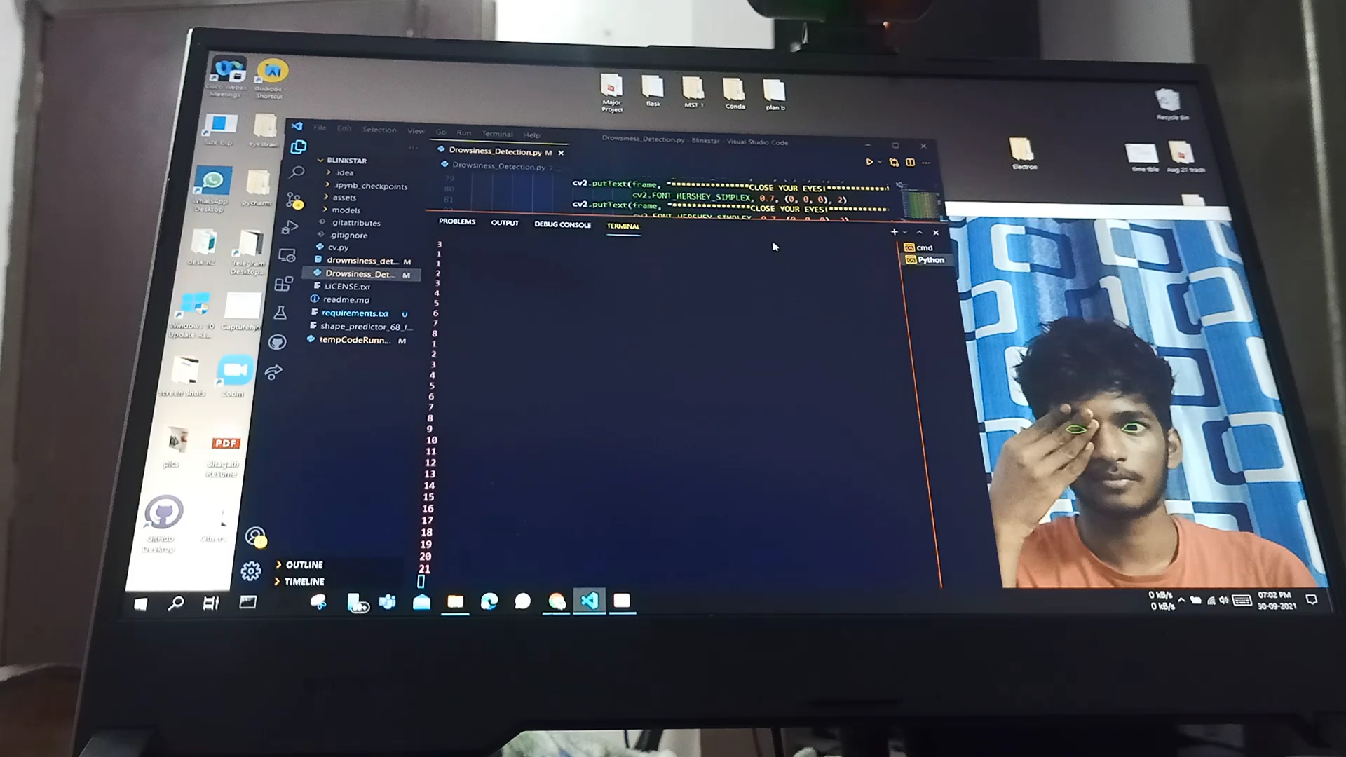
Results and Outputs:
Ignores casual blinks that are under 1.2 sec:
Keeps the screen light on in case one eye is open
Also puts the screen on in case no eyes or no face is detected

Slide 18

Results and Outputs:
Background running Electron GUI:

Slide 19
Conclusion:
It increases the productivity of the user as people likely tend to watch useless content after completing the desired content
To a major extent, this will also protect users privacy by making the content invisible to others But it is not totally safe when someone turn off light or when you cannot be recognized due physical or surrounding light changes.
Efficiently save a lot of energy that will be consumed over screen display light, though it uses camera for eye detection in most of the cases the power consumed due to camera is much less than the display light

Slide 20
Conclusion:
Of course it will not work while your eyes are unable detect or not visible for detecting your eyes. But it will not turn your screen off so you can keep using the device
For demonstrating purpose we have made it as an application based GUI interface to execute. But this can be directly useful to add as an operating system feature
We believe that the operating systems will only look at this as up gradation of their existing system and we hope it does not look at this as a downfall in commercial use of computers

Slide 21
Future Scope:
This can be further can be improved to make it deployable in multiple operating system because every operating system is different to Modify the setting differently.
It can be incorporated existing operating system as it is the medium in between human and digital interaction it also a social responsibility to take care of their users.
We also appreciate while combining artificial intelligence to automatically understand the individual blink rate monitoring to give recommended setting for pop up reminder to understand its user from the past blinking habits.

Slide 22
References:
www.ncbi.nlm.nih.gov/pmc/articles/PMC4170366/ Computer vision syndrome
2. https://www.ncbi.nlm.nih.gov/pmc/articles/PMC6118863/ eye problems due to blink rate
3. www.aoa.org/healthy-eyes/eye-and-vision-conditions/computer-visionsyndrome?sso=y digital eye strain due to computer vision
4. Eye blink detection |Tereza Soukupov ́a and JanˇCechCenter for Machine Perception, Department of CyberneticsFaculty of Electrical Engineering, Czech Technical University in Prague
5. pypi.org/project/screen-brightness-control/ python for controlling display brigntness
6. geeksforgeeks.org/control-laptop-screen-brightness-using-python/
7. www.pythongasm.com/desktop-notifications-with-python/ Desktop notifications for Operating systems linux, windows, MacOS
8. https://medium.com/@abulka/electron-python-4e8c807bfa5e Python deployable electron applicatio

